Slide 1
Parcial 1 y 2 SD II (nov. 17 del 2009)
Fernando Bolivar Monsalve
Cod 0623272

Slide 2
I) Teoría
1. Diseñar la arquitectura interna de una RAM de 4M bytes y una DRAM de 4Mbits
A0 - A10
22 bits de dirección = 2¹¹ x 2¹¹
A0 – A21
11
Dec. 11 a 2¹¹
2¹¹
Dec.
11
a
2¹¹
11
2¹¹
D7-D0
A11 – A21
2¹¹ x 2¹¹

Slide 3
DRAM de 4Mbits
CS W/R
2¹¹
A0 – A22
Dirección
Fila
11
2¹¹
D7-D0
Deco.
Fila
2¹¹ x 2¹¹
2¹¹
Dirección
Columna
11
Deco.
Columna

Slide 4
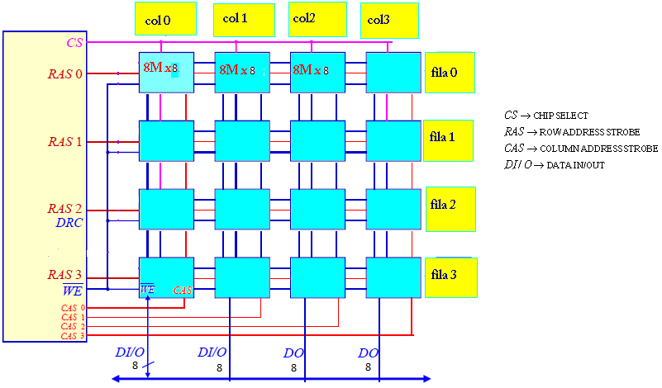
2) Implementar una memoria DRAM de 128M bytes usando DRAM de 8M bits

Slide 5
II) Diseño
2. Diseñar una FSM Mealy asíncrona para controlar un motor DC:
- El motor arranca y gira en sentido normal cuando detecta la secuencia X1X1X2X2; salida Z1Z0=01
- El motor arranca y gira en sentido contrario cuando detecta la secuencia X2X1X1X2; salida Z1Z=10
- El motor se detiene cuando detecta la secuencia X2X1X1X1; salida Z1Z0=00
- El motor gira en sentido contrario cuando detecta la secuencia X2X2X1X1 pero primero debe parar antes de cambiar de giro; salida Z1Z0=00*. Prioridad cambio de giro

Slide 6
DIAGRAMA DE ESTADOS
X1
00
X2
01
X1
00
X1
00
X2
00
X2
01
S0
S1
S2
S3
S4
X2
01
X2
00
X1
00
X1
01
X2
00
X2
01
X2
00
S5
S9
S14
X1
00
X1
00*
X1
01
X1
00
X2
00
X2
01
X1
10
S6
S17
S15
X2
01
X1
00
X1
01
S7
X2
10
S16
X1
00
X1
00
X2
10
X2
10
X1
10
X1
10
X2
10
S8
S10
S11
X2
10
X2
10
X1
01
X1
10
X1
00*
X2
10
X2
01
S12
S13
S18

Slide 7
Tabla de estados para el FF D
 | Para X1 |  |  |  |  |  |  |  |  |  |  |  | Para X2
 | EP |  |  |  |  | PE |  |  |  |  | Salida |  | EP |  |  |  |  | PE |  |  |  |  | Salida
 | Q4 | Q3 | Q2 | Q1 | Q0 | Q4* | Q3* | Q2* | Q1* | Q0* | Z1 | Z0 | Q4 | Q3 | Q2 | Q1 | Q0 | Q4* | Q3* | Q2* | Q1* | Q0* | Z1 | Z0
0 | 0 | 0 | 0 | 0 | 0 | 0 | 0 | 0 | 0 | 1 | 0 | 0 | 0 | 0 | 0 | 0 | 0 | 0 | 0 | 1 | 0 | 1 | 0 | 0
1 | 0 | 0 | 0 | 0 | 1 | 0 | 0 | 0 | 1 | 0 | 0 | 0 | 0 | 0 | 0 | 0 | 1 | 0 | 0 | 1 | 0 | 1 | 0 | 0
2 | 0 | 0 | 0 | 1 | 0 | 0 | 0 | 0 | 1 | 0 | 0 | 0 | 0 | 0 | 0 | 1 | 0 | 0 | 0 | 0 | 1 | 1 | 0 | 0
3 | 0 | 0 | 0 | 1 | 1 | 0 | 0 | 1 | 1 | 0 | 0 | 0 | 0 | 0 | 0 | 1 | 1 | 0 | 0 | 1 | 0 | 0 | 0 | 1
4 | 0 | 0 | 1 | 0 | 0 | 0 | 1 | 0 | 0 | 1 | 0 | 1 | 0 | 0 | 1 | 0 | 0 | 0 | 0 | 1 | 0 | 0 | 0 | 1
5 | 0 | 0 | 1 | 0 | 1 | 0 | 0 | 1 | 1 | 0 | 0 | 0 | 0 | 0 | 1 | 0 | 1 | 0 | 0 | 1 | 0 | 1 | 0 | 0
6 | 0 | 0 | 1 | 1 | 0 | 0 | 0 | 1 | 1 | 1 | 0 | 0 | 0 | 0 | 1 | 1 | 0 | 0 | 0 | 1 | 0 | 1 | 0 | 0
7 | 0 | 0 | 1 | 1 | 1 | 0 | 0 | 0 | 1 | 0 | 1 | 0 | 0 | 0 | 1 | 1 | 1 | 0 | 1 | 0 | 0 | 0 | 1 | 0
8 | 0 | 1 | 0 | 0 | 0 | 0 | 1 | 0 | 1 | 0 | 1 | 0 | 0 | 1 | 0 | 0 | 0 | 0 | 1 | 1 | 0 | 0 | 1 | 0
9 | 0 | 1 | 0 | 0 | 1 | 1 | 0 | 0 | 0 | 1 | 1 | 0 | 0 | 1 | 0 | 0 | 1 | 0 | 1 | 1 | 1 | 0 | 0 | 1
10 | 0 | 1 | 0 | 1 | 0 | 0 | 1 | 0 | 1 | 1 | 1 | 0 | 0 | 1 | 0 | 1 | 0 | 0 | 1 | 0 | 0 | 0 | 1 | 0
11 | 0 | 1 | 0 | 1 | 1 | 0 | 0 | 0 | 1 | 0 | 0 | 0 | 0 | 1 | 0 | 1 | 1 | 0 | 1 | 0 | 0 | 0 | 1 | 0
12 | 0 | 1 | 1 | 0 | 0 | 0 | 1 | 1 | 0 | 1 | 1 | 0 | 0 | 1 | 1 | 0 | 0 | 0 | 1 | 1 | 0 | 0 | 1 | 0
13 | 0 | 1 | 1 | 0 | 1 | 1 | 0 | 0 | 1 | 0 | 0 | 1 | 0 | 1 | 1 | 0 | 1 | 0 | 1 | 0 | 0 | 0 | 1 | 0
14 | 0 | 1 | 1 | 1 | 0 | 0 | 1 | 1 | 1 | 1 | 0 | 1 | 0 | 1 | 1 | 1 | 0 | 0 | 0 | 1 | 0 | 0 | 0 | 1
15 | 0 | 1 | 1 | 1 | 1 | 1 | 0 | 0 | 0 | 0 | 0 | 1 | 0 | 1 | 1 | 1 | 1 | 0 | 1 | 1 | 1 | 0 | 0 | 1
16 | 1 | 0 | 0 | 0 | 0 | 0 | 0 | 0 | 1 | 0 | 0 | 0 | 1 | 0 | 0 | 0 | 0 | 0 | 1 | 1 | 1 | 0 | 0 | 1
17 | 1 | 0 | 0 | 0 | 1 | 1 | 0 | 0 | 0 | 1 | 1 | 0 | 1 | 0 | 0 | 0 | 1 | 0 | 1 | 0 | 0 | 0 | 1 | 0
18 | 1 | 0 | 0 | 1 | 0 | 1 | 0 | 0 | 1 | 0 | 0 | 1 | 1 | 0 | 0 | 1 | 0 | 0 | 1 | 1 | 1 | 0 | 0 | 1

Slide 8
Tabla de estados para el FF D
 | Para X1 |  |  |  |  |  |  |  |  |  | Para X2
 | D4 | D3 | D2 | D1 | D0 | C4 | C3 | C2 | C1 | C0 | D4 | D3 | D2 | D1 | D0 | C4 | C3 | C2 | C1 | C0
0 | X | X | X | X | 1 | 0 | 0 | 0 | 0 | 1 | X | X | 1 | X | 1 | 0 | 0 | 1 | 0 | 1
1 | X | X | X | 1 | 0 | 0 | 0 | 0 | 1 | 1 | X | X | 1 | X | X | 0 | 0 | 1 | 0 | 0
2 | X | X | X | X | X | 0 | 0 | 0 | 0 | 0 | X | X | X | X | 1 | 0 | 0 | 0 | 0 | 1
3 | X | X | 1 | X | 0 | 0 | 0 | 1 | 0 | 1 | X | X | 1 | 0 | 0 | 0 | 0 | 1 | 1 | 1
4 | X | 1 | 0 | X | 1 | 0 | 1 | 1 | 0 | 1 | X | X | X | X | X | 0 | 0 | 0 | 0 | 0
5 | X | X | X | 1 | 0 | 0 | 0 | 0 | 1 | 1 | X | X | X | X | X | 0 | 0 | 0 | 0 | 0
6 | X | X | X | X | 1 | 0 | 0 | 0 | 0 | 1 | X | X | X | 0 | 1 | 0 | 0 | 0 | 1 | 1
7 | X | X | 0 | X | 0 | 0 | 0 | 1 | 0 | 1 | X | 1 | 0 | 0 | 0 | 0 | 1 | 1 | 1 | 1
8 | X | X | X | 1 | X | 0 | 0 | 0 | 1 | 0 | X | X | 1 | X | X | 0 | 0 | 1 | 0 | 0
9 | 1 | 0 | X | X | X | 1 | 1 | 0 | 0 | 0 | X | X | 1 | 1 | 0 | 0 | 0 | 1 | 1 | 1
10 | X | X | X | X | 1 | 0 | 0 | 0 | 0 | 1 | X | X | X | 0 | X | 0 | 0 | 0 | 1 | 0
11 | X | 0 | X | X | 0 | 0 | 1 | 0 | 0 | 1 | X | X | X | 0 | 0 | 0 | 0 | 0 | 1 | 1
12 | X | X | X | X | 1 | 0 | 0 | 0 | 0 | 1 | X | X | X | X | X | 0 | 0 | 0 | 0 | 0
13 | 1 | 0 | 0 | 1 | 0 | 1 | 1 | 1 | 1 | 1 | X | X | 0 | X | 0 | 0 | 0 | 1 | 0 | 1
14 | X | X | X | X | 1 | 0 | 0 | 0 | 0 | 1 | X | 0 | X | 0 | X | 0 | 1 | 0 | 1 | 0
15 | 1 | 0 | 0 | 0 | 0 | 1 | 1 | 1 | 1 | 1 | X | X | X | X | 0 | 0 | 0 | 0 | 0 | 1
16 | 0 | X | X | 1 | X | 1 | 0 | 0 | 1 | 0 | 0 | 1 | 1 | 1 | X | 1 | 1 | 1 | 1 | 0
17 | X | X | X | X | X | 0 | 0 | 0 | 0 | 0 | 0 | 1 | X | X | 0 | 1 | 1 | 0 | 0 | 1
18 | X | X | X | X | X | 0 | 0 | 0 | 0 | 0 | 0 | 1 | 1 | X | x | 1 | 1 | 1 | 0 | 0

Slide 9
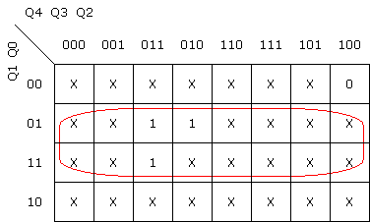
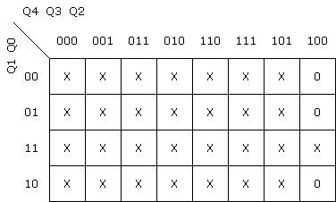
Mapas K
X1
X2
D4
D4
D4=(Q0)X1

Slide 10
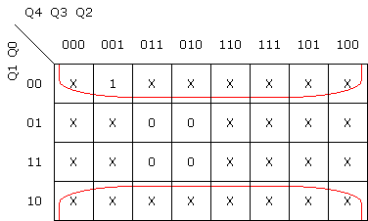
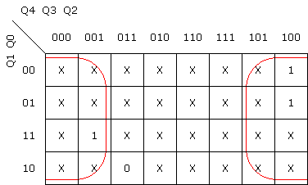
Mapas K
X1
X2
D3
D3
D3=(~Q0)X1+(~Q3)X2

Slide 11
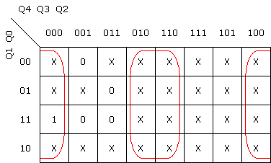

Mapas K
X1
X2
D2
D2
D2=(~Q2)X1+(~Q2)X2

Slide 12
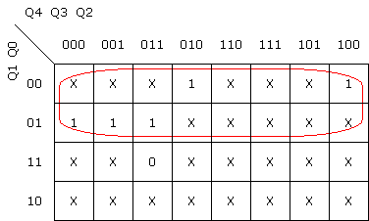

Mapas K
X1
X2
D1
D1
D1=(~Q1)X1+(~Q1)X2

Slide 13
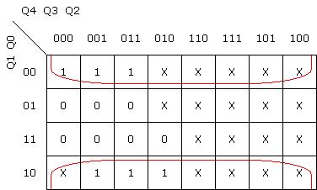

Mapas K
X1
X2
D0
D0
D0=(~Q0)X1+(~Q0)X2

Slide 14
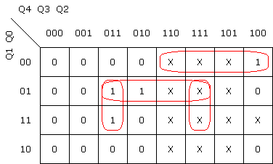
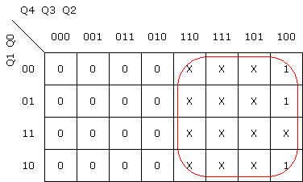
Mapas K
X1
X2
C4
C4
C4=((Q3*~Q1*Q0)+(Q3*Q2*Q0)+(Q4*~Q1*~Q0))X1+(Q4)X2

Slide 15
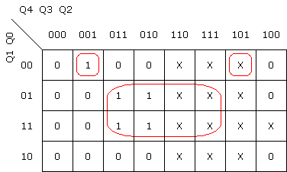
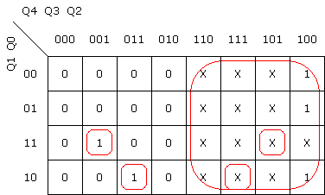
Mapas K
X1
X2
C3
C3
C3=((~Q3*Q2*~Q1*~Q0)+(Q3*Q0))X1+((Q3*Q2*Q1*~Q0)+(~Q3*Q2*Q1*Q0)+(Q4))X2

Slide 16
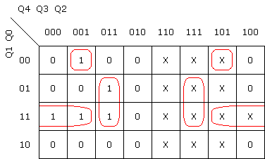
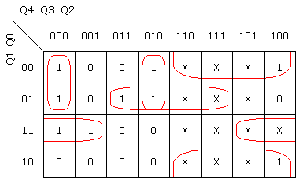
Mapas K
X1
X2
C2
C2
C2=((~Q3*Q1*Q0)+(~Q3*Q2*~Q1*~Q0)+(Q3*Q2*Q0))X1+((Q3*~Q1*Q0)+(~Q3*Q1*Q0)+(~Q4*~Q2*~Q1)+(Q4*~Q0))X2

Slide 17
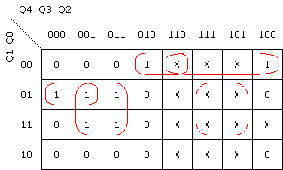
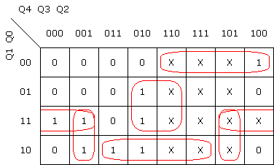
Mapas K
X1
X2
C1
C1
C1=((~Q4*~Q3*~Q1*Q0)+(Q2*Q0)+(Q3*~Q2*~Q1*~Q0)+(Q4*~Q1*~Q0))X1+((Q4*~Q1*~Q0)+(Q3*~Q2*Q0)+(Q3*Q1*~Q0)+(~Q3*Q1*Q0)+(~Q3*Q2*Q1))X2

Slide 18
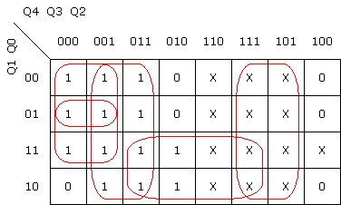
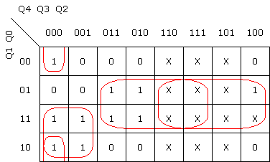
Mapas K
X1
X2
C0
C0
C0=((~Q4*~Q3*~Q1)+(Q2)+(Q3*Q1)+(~Q4*~Q3*Q0))X1+((~Q4*~Q3*~Q2*~Q0)+(Q3*Q0)+(Q4*Q0)+(~Q4*~Q3*Q1))X2

Slide 19
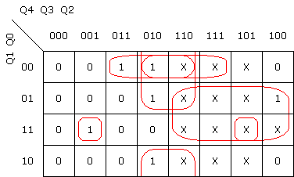
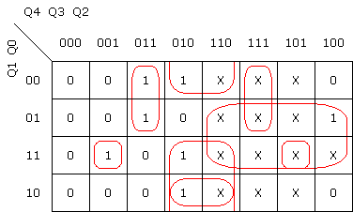
Mapas K
X1
X2
Z1
Z1
Z1=((~Q3*Q2*Q1*Q0)+(Q3*~Q1*~Q0)+(Q3*~Q2*~Q0)+(Q3*~Q2*~Q1)+(Q4*Q0))*X1+((~Q3*Q2*Q1*Q0)+(Q3*~Q2*Q1)+(Q3*Q2*~Q1)+(Q4*Q0)+(Q3*~Q2*~Q0))*X2

Slide 20
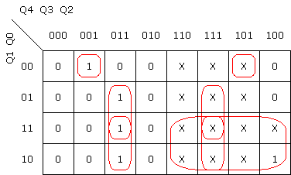
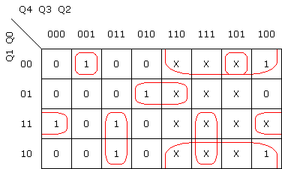
Mapas K
X1
X2
Z0
Z0
Z0=((~Q3*Q2*~Q1*~Q0)+(Q3*Q2*Q0)+(Q3*Q2*Q1)+(Q4*Q1))*X1+((~Q3*Q2*~Q1*~Q0)+(Q3*~Q2*~Q1*Q0)+(~Q3*~Q2*Q1*Q0)+(Q3*Q2*Q1)+(Q4*~Q0))*X2

Slide 21
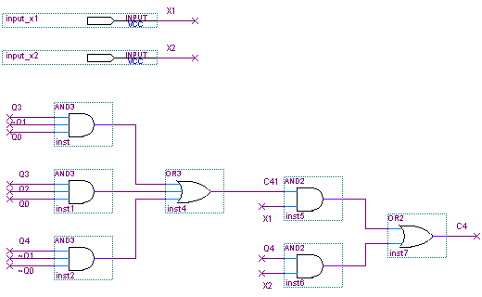
Implementación en Quartus

Slide 22
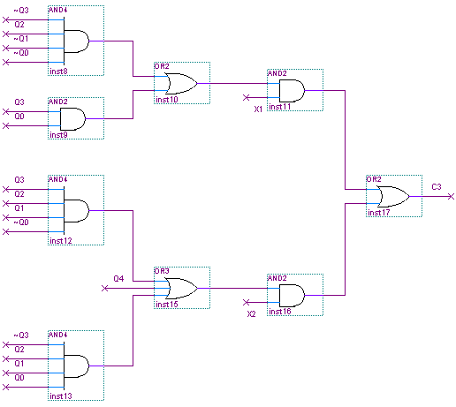
Implementación en Quartus

Slide 23
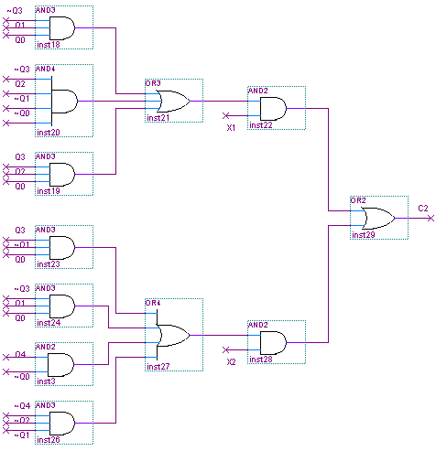
Implementación en Quartus

Slide 24
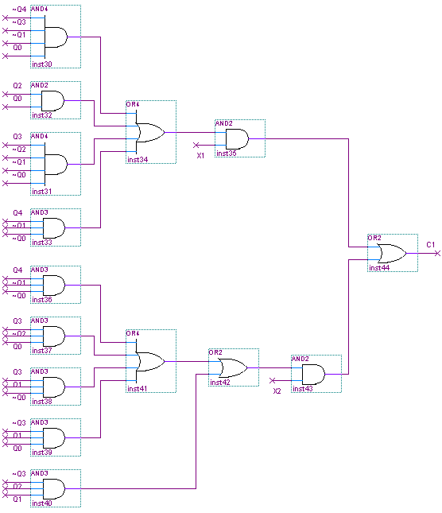
Implementación en Quartus

Slide 25
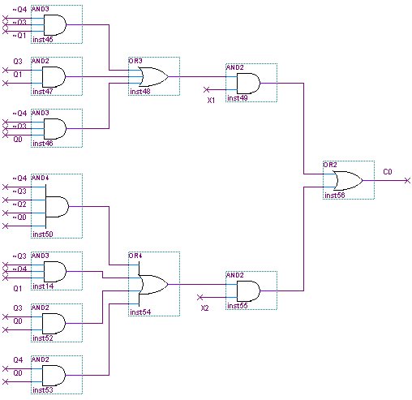
Implementación en Quartus

Slide 26
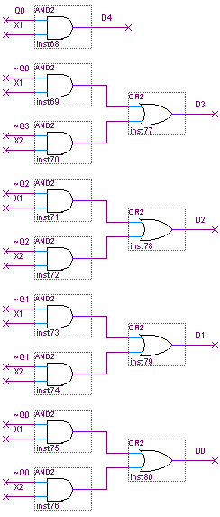
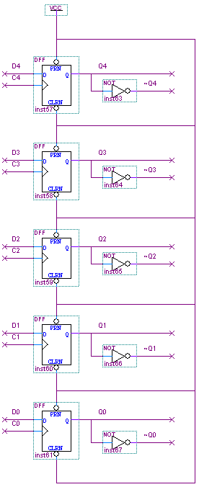
Implementación en Quartus

Slide 27
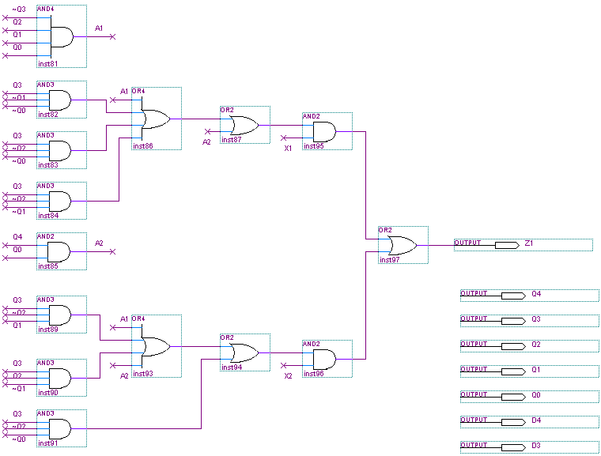
Implementación en Quartus

Slide 28
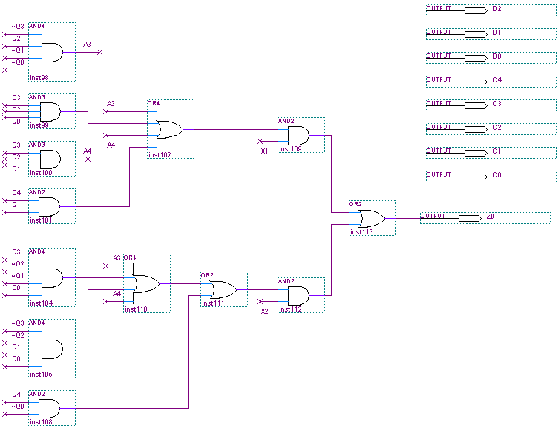
Implementación en Quartus

Slide 29
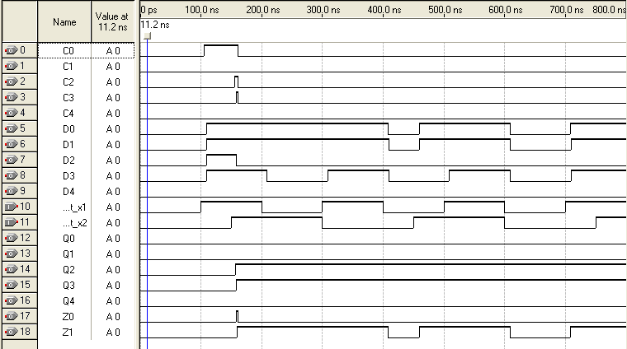
Simulación

